Slide 1
Graphs
3rd Grade
College of Computer Science and Information Technology
Department of Computer Science
Data Structures
Lecture 6
Instructor: Ghazwan Abdulnabi Al-Ali
University of Basrah, Iraq

Slide 2
Introduction to Graphs 1
Graphs are data structures rather like trees.
A graph is a finite set of nodes with edges between nodes
The edges in a tree represent quick ways to get from node to node.
nodes in a graph may represent cities, nodes are called vertices
Figure 4.1-a shows a simplified map of the freeways in the vicinity of San Jose, California. Figure 4.1-b shows a graph that models these freeways.
Figure 4.1

Slide 3
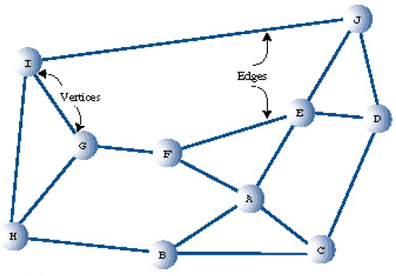
Introduction to Graphs 2
Adjacency:
  Two vertices are said to be adjacent to one another if they are connected by a single edge.
  vertices I and G are adjacent, but vertices I and F are not 0 in figure 4.1 - b.
  0 is adjacent to 1. but 1 is not adjacent to 0 in figure 4.1 - c.
Paths
  A path is a sequence of edges. Figure 4.1 - b shows a path from vertex B to vertex J that passes through vertices A and E. We can call this path BAEJ.
  can be more than one path between two vertices; another path from B to J is BCDJ.
b
1
0
2
4
3
c
Figure 4.1

Slide 4
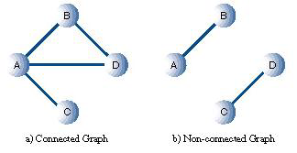
Connected Graphs
A graph is said to be connected if there is at least one path from every vertex to every other vertex
A non-connected graph consists of several connected components. In Figure 4.2-b, A and B are one connected component, and C and D are another
Figure 4.2

Slide 5
Directed and Weighted Graphs
V1
V2
non-directed and directed graphs: The graphs in Figure 4.3-a are non-directed graphs.
weight :In some graphs, edges are given a weight, a number that can represent the physical distance between two vertices, or the time it takes to get from one vertex to another, or how much it costs to travel from vertex to vertex
V4
V3
Figure 4.3-a non-directed
Figure 4.3-b directed

Slide 6
Examples of Graphs
V(G1)={0,1,2,3}, four vertices E(G1)={(0,1),(0,2),(0,3),(1,2),(1,3),(2,3)}, six edges
V(G2)={0,1,2,3,4,5,6} E(G2)={(0,1),(0,2),(1,3),(1,4),(2,5),(2,6)}
0
0
1
2
1
2
3
3
4
5
6
G1
G2
complete undirected graph: n(n-1)/2 edges
complete directed graph: n(n-1) edges
complete graph
incomplete graph

Slide 7
Graph Representations
Adjacency Matrix
Adjacency Lists

Slide 8
Adjacency Matrix
Let G=(V,E) be a graph with n vertices.
The adjacency matrix of G is a two-dimensional n by n array, say adj_mat
If the edge (vi, vj) is in E(G), adj_mat[i][j]=1
If there is no such edge in E(G), adj_mat[i][j]=0
The adjacency matrix for an undirected graph is symmetric.

Slide 9
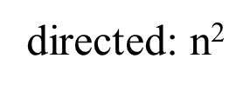
Adjacency Matrix Cont.
adjMat[0 ][ 0] = 0;
adjMat[0 ][ 1] = 1;
adjMat[0 ][ 2] = 1;
adjMat[0 ][ 3] = 1;
adjMat[0 ][ 4] = 0;
adjMat[1 ][ 0] = 1;
adjMat[1 ][ 1] = 0;
adjMat[1 ][ 2] = 0;
adjMat[1 ][ 3] = 1;
adjMat[1 ][ 4] = 1;
…
…

Slide 10
The Adjacency List
A graph of n nodes is represented by a one-dimensional array L of linked lists, where:
  L[i] is the linked list containing all the nodes adjacent from node i.
  The nodes in the list L[i] are in no particular order
0
1
2
L[i]
3
0
1
2
3
1
2
3
0
2
3
0
1
3
0
1
2
G1

Slide 11
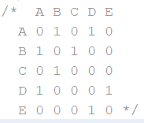
REPRESENTING A GRAPH IN A PROGRAM
class Vertex
{
public char label; // label (e.g. 'A’)
public boolean wasVisited;
public Vertex(char lab) // constructor
{
label = lab;
wasVisited = false;
}
} // end class Vertex
G₁
A
B
D
C
E

Slide 12
REPRESENTING A GRAPH IN A PROGRAM Cont.
public class Graph {
private final int MAX_VERTS = 20;
private Vertex vertexList[]; // array of vertices
private int adjMat[][]; // adjacency matrix
private int nVerts; // current number of vertices
// -------------------------------------------------------------
public Graph() // constructor
{
vertexList = new Vertex[MAX_VERTS];
// adjacency matrix
adjMat = new int[MAX_VERTS] [MAX_VERTS];
nVerts = 0;
for(int j=0; j<MAX_VERTS; j++) // set adjacency
for(int k=0; k<MAX_VERTS; k++) // matrix to 0
adjMat[j][k] = 0;
} // end constructor
public void addVertex(char lab) // argument is label
{
vertexList[nVerts++] = new Vertex(lab);
}
// -------------------------------------------------------------
public void addEdge(int start, int end)
{
adjMat[start][end] = 1;
adjMat[end][start] = 1;
}
// -------------------------------------------------------------
public void displayVertex(int v)
{
System.out.print(vertexList[v].label+" ");
}

Slide 13
public static void main(String[] args) {
Graph theGraph = new Graph();
theGraph.addVertex('A'); // 0
theGraph.addVertex('B'); // 1
theGraph.addVertex('C'); // 2
theGraph.addVertex('D'); // 3
theGraph.addVertex('E'); // 4
theGraph.addEdge(0, 1); // AB
theGraph.addEdge(1, 2); // BC
theGraph.addEdge(0, 3); // AD
theGraph.addEdge(3, 4); // DE
theGraph.displayVertice();
}
}
public void displayVertice()
{
System.out.print(" ");
for (int i=0;i<nVerts;i++)
displayVertex(i);
System.out.println();
for (int i=0;i<nVerts;i++)
{
displayVertex(i);
for(int j=0;j<nVerts;j++)
System.out.print(adjMat[i][j]+" ");
System.out.println();
}
} // end class Graph
G₁
A
B
D
C
E

Slide 14
Thank You

